Slide 1


2nd Public Workshop: Trip & Equipment Grant Allocation Methodology
July 28, 2020

Slide 2

Objectives of the Public Workshop
Gain an understanding of the current allocation methodology of the Trip & Equipment Grant;
Explore datasets that could be applied to (or enhanced in) the funding formula; and
Gather input on potential changes to the methodology adopted in Rule 41-2.014, FAC

Slide 3

Meeting Rules
This is a public meeting under Florida’s Government in the Sunshine Act.
This meeting is being recorded.
All audio and phone lines are muted.
Speakers that submitted a public comment form will be selected first.
Webinar speakers will be unmuted when called on by the meeting facilitator.
Phone participants will be instructed on unmuting their phone lines.
All speakers during public input will be limited to 5 minutes.

Slide 4

Webinar Tutorial

Slide 5

Funding Allocation Study
Summary of Analysis & Proposed Changes

Slide 6

“Decisions will be better, and better understood and supported, if transparency, discussion and debate, communication and collaboration precede them.”
Robert Gates
Former U.S. Secretary of Defense

Slide 7
Study Objectives
Conduct an in-depth analysis of data used within the current allocation methodology
01
Facilitate stakeholder workshops to gather input on funding models for future consideration
02
Develop a final report that recommends changes to the funding methodology to be implemented in rule by July 1, 2021.
03

Slide 8
Guiding Principles
Access
Ensure Floridians who are transportation disadvantaged have access to community
Innovation
Allow local systems to test and apply new ideas to services.
Coordination
Promote cost-effective delivery of TD services.
Accountability
Ensure state taxpayer funding is being spent for its intended purpose.
Transparency
Make information available and understandable to stakeholders.

Slide 9

Trip & Equipment Grant
Allocation methodology established in Rule 41-2.014(5), FAC.
Consists of two components:
Base Funding – Based on a county’s equivalent allocation in FY1999-00.
Formula Funding – Based on four variables that equally measure demand and performance of transportation disadvantaged services in a county:
Total Population (demand)
Total Geographic Square Miles (demand)
Total Annual Operating Report (AOR) Trips (performance)
Total AOR Vehicle Miles (performance)
Funds are disbursed to the county’s Community Transportation Coordinators (CTC) after TD services are rendered.

Slide 10


Allocations VS Disbursements

Slide 11

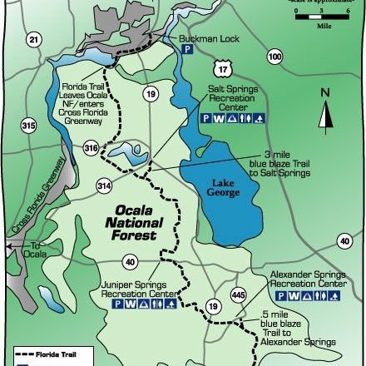
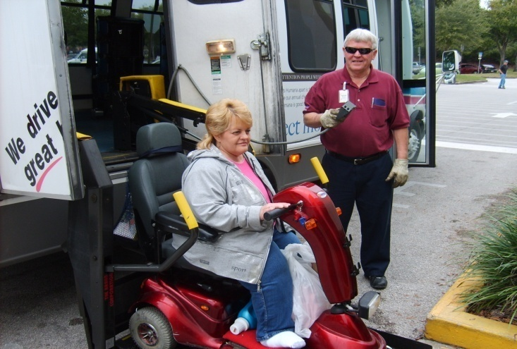
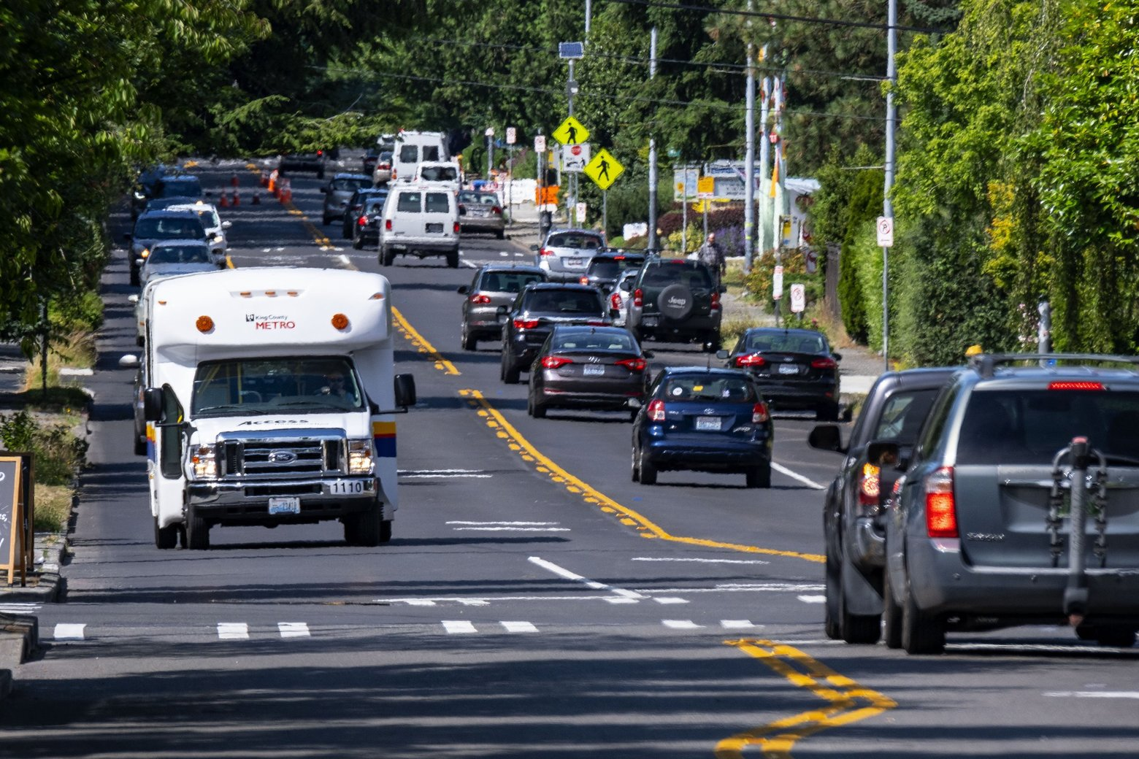
Data Sources Explored by Study
The American Community Survey (ACS) – 5-Year Population Data
Federal Highway Administration (FHWA) – Public Roads Mileage Data
CTD Annual Operating Report (AOR) – Systemwide Service Data
CTD Trip & Equipment Program Invoices – TD (Non-Sponsored) Service Data

Slide 12
Analysis of Individual Variables
Each dataset is identical or analogous to a variable within the Formula
Proposed models consider balance of demand vs performance variables.
This study explores the use of more precise estimates or measures within each of these variables.
Intended to adhere the variables to the guiding principles of the study by using the more precise measures.

Slide 13

Summary of Proposed Changes
The study presents four changes (variables) for consideration:
TD Population – Using ACS 5-year data (Table C18130), allocate funds more directly to county residents eligible to be served by the TD program.
Centerline Miles – As an alternative to square miles, allocate funds to a county’s total miles of public roads using FHWA data.
T&E Grant Funded Services – Instead of AOR systemwide trips/miles, allocate funds only for TD non-sponsored services (trips, miles, bus passes) using T&E invoice data.
Base Funding – Add the Base as a variable within the Formula and allocate funds based on a percent of a county’s previous year allocation (instead of the amount from FY1999-00).

Slide 14

Proposed Variable Weights
The funding models for consideration assign different weights to datasets within each of the variables, with “1.0” as the standard value.
TD Population – All individuals who fall under at least one of three TD eligible groups (disabled, below poverty, and/or 65 years and older) are weighted equally at 1.0
CLM – Roads data are categized into four population sizes (rural, small urban, small urbanized, and large urbanized), all equally weighted at 1.0.
T&E Services – The different types of trips and bus passes are weighted at an amount relative to the unit cost (or rate) of an ambulatory trip.
A wheelchair trip, for example, is weighted at 1.7 because it is reimbursed 1.7 times the cost of an ambulatory trip.
Miles are weighted at 0.1 the amount for an equivalent type of trip, so that each additional mile in a trip adds 0.1 to the total for the trip.

Slide 15

Calculating Statewide Shares: Alachua County
Once the weighted totals for each variable are tallied, a statewide share for each county by variable can be calculated. Using Alachua County as an example:
Share of TD Population: (96,121/7,589,002) = 1.27%
Share of Centerline Miles: (1,820,154/123,099,224) = 1.48%
Share of T&E Services: (44,483,050/5,290,813.776) = 0.84%
Share of Base: ($650,821/$56,538,360) = 1.15%
Any model that gives greater weight to a variable that represents a higher statewide share for a county will result in more funds being allocated toward that same county.

Slide 16

Models for Consideration
The study presents three models, with varying weighted totals and statewide shares by variable:
Model | Demand (TD + CLM) | Performance | Base | Description
Model 1 | 12.5%+12.5% | 25% | 50% | “Status Quo” approach, uses the similar balance as current formula, just with different datasets
Model 2 | 6.25%+6.25% | 37.5% | 50% | Performance-driven approach, where more weight is given to prior year performance in T&E services
Model 3 | 18.75%+18.75% | 12.5% | 50% | Demand-driven approach, where more weight is given to a county’s TD population and CLM

Slide 17

Calculating Alachua County Share in Each Model
With statewide shares calculated for each county and weights assigned to each variable, it then becomes possible to calculate each county’s share of the total amount appropriated for the T&E Grant (allocation factor) under each model. Taking Alachua County as an example again:
Proposed Variable: Model 1 Model 2 Model 3
Share of TD Population: (1.27%*12.5%) (1.27%*6.25%) (1.27%*18.75%)
Share of CLM: +(1.48%*12.5%) +(1.48%*6.25%) +(1.48%*18.75%)
Share of T&E Services: +(0.84%*25%) +(0.84%*37.5%) +(0.84%*12.5%)
Share of Base: +(1.15%*50%) +(1.15%*50%) +(1.15%*50%)
Allocation Factor =1.13% =1.06% =1.20%

Slide 18
Allocation Amounts for Alachua County Under Each Model
Finally, after calculating the allocation factor under each model, it becomes possible to determine the allocation amount for each county. Using Alachua County as the example:
*Models 1, 2, and 3 assume total funding equal to FY 2020-21 appropriation
Proposed Variable | Model 1 | Model 2 | Model 3 | FY2019-20 (Pre-”Hold Harmless”) | FY2018-19
TD Population | $89,795.08 | $$44,897.54 | $134,692.62
CLM | $104,826.66 | $52,413.33 | $157,239.99
T&E Services | $119,212.29 | $178,818.43 | $59,606.14
Base | $326,435.42 | $326,435.42 | $326,435.42
Total Allocation | $640,269.45 | $602,564.72 | $677,974.18 | $650,820.54 | $605,854.51

Slide 19

Discussion of Stakeholder Input
Summary of Feedback Received at 1st Public Workshop

Slide 20

Questions Presented to Stakeholders…
Should the funding model weigh TD groups (i.e., older adults, individuals with disabilities, and persons with low-income) equally or differently?
What about individuals who fall in more than one group (e.g., living with a disability and below poverty)?
Should the funding model weigh population size areas (i.e., rural, small urban, large urbanized, etc.) equally or differently?
If miles of public roads are considered, should the funding model also consider functional classifications (e.g., Interstates, local roads, etc.) and/or number of lanes?
In the models presented, different weights are assigned to different trip types (ambulatory, wheelchair, etc.). Are these weights appropriate?
What is the appropriate weight for vehicle miles? The models presented weigh miles one-tenth the level that trips are.

Slide 21
…Questions Presented to Stakeholders
In the models presented, the Base Funding is an added variable to the Formula and based on a percent of a county’s previous year allocation:
Is weighting this variable at 50% appropriate?
Is measuring this variable according to a county’s statewide share of total allocations from the previous year appropriate?
Is Base Funding more important to smaller counties or larger counties?
The models presented consider the 5-year estimates on population, rather than 1-year data, to show a smooth trend:
Should the other variables presented in these models attempt to use a similar approach, such as rolling a multi-year average?

Slide 22

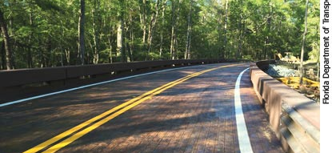
Feedback on Demand Variables
The TD eligible population is a better metric for estimating demand than general population.
Rural systems tend to travel further distances to access certain services, such as medical facilities in neighboring urbanized areas.
Using centerline miles reinserts population as a second variable in the formula, which favors more urbanized counties.
Consider unmet and latent travel demand as an additional variable (recommended by the Center for Urban Transportation Research in 2014).

Slide 23
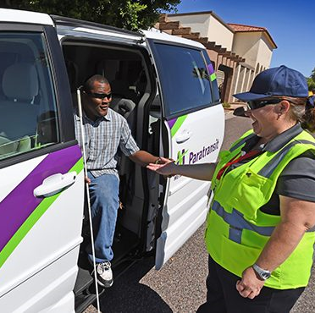
Feedback on Performance Variable
The AOR trips/miles should be removed from the formula due to a lack of credible, consistent data.
Greater weight should be given to T&E invoice miles to account for the cost of delivering trips at longer distances (for both rural and urban systems).
Debate over the use of bus passes within the formula:
Some argue removal to favor rural systems that do not have robust fixed-route transit services.
Some argue for inclusion of actual trips/miles to favor fixed-route systems that serve TD (low-income) riders.
Consider impact on fixed route systems that cannot bill for ADA paratransit services under TD program.
Consider weighing trip purposes (medical, nutrition, etc.), with a higher percentage given to medical.
How will trips that exceed the allocated amount (“overage” in T&E invoice data) be addressed?

Slide 24

Feedback on Base and Other Considerations
The base variable is critical for system planning from year-to-year, especially for critical medical trips.
A “floor” should be considered to prevent a certain percentage of loss in allocation.
How do the funding models consider the impact of COVID-19 (i.e., T&E invoice trips)?
Consider an inventory of total public transportation funding or legacy allocations per county.

Slide 25

A Closer Look at Public Roads
Why Should It Be A Variable in the Formula?

Slide 26
Population as a stand-alone variable heavily favors larger counties.
Two-County Model
County | Appropriation: $1,000,000
 | Population | 100%
 | CLM | 0%
Glades | $12,700.13
Pinellas | $987,299.87

Slide 27
Compared to population alone, CLM as a variable overwhelmingly benefits smaller counties.
Two-County Model
County | Appropriation: $1,000,000
 | Population | 0%
 | CLM | 100%
Glades | $95,607.90
Pinellas | $904,392.10

Slide 28
Combined, these variables balance allocations by valuing CLM per capita (population)
Two-County Model
County | Appropriation: $1,000,000
 | Population | 50%
 | CLM | 50%
Glades | $54,154.01
Pinellas | $945,845.99

Slide 29

Other Factors to Consider
Performance & Base Variables

Slide 30
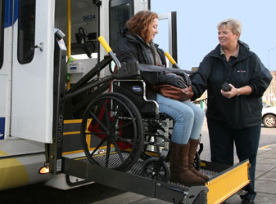
Response to Initial Public Input…
Proposed models replace AOR with T&E invoice data within the formula:
Only consider trips/miles/bus passes invoiced to T&E Grant; and
Remove trips not funded by T&E Grant from consideration (e.g., FTA Grants, etc.).
Proposed models only consider bus passes (not actual bus trips/miles).
Bus passes cannot be removed without a change in the reimbursement process.
Inclusion of ADA complimentary paratransit would require change in T&E reimbursement process.

Slide 31

…Response to Initial Public Input
Trip purposes (i.e., medical, job-training, etc.) not identified in T&E invoice data:
Adding to state formula would remove local autonomy to set trip priorities.
Proposed models can be adjusted to weigh vehicles miles at a higher level:
What should these weights be relative to trips?
The Base Variable is more adjustable than a “floor” and offsets significant decreases and increases in allocations:
What percent should this be weighed?

Slide 32

Public Input
Stakeholders may submit feedback and find additional information at: https://ctdallocationstudy.com/
Contact information: David Darm, CTD Executive Director, David.Darm@dot.state.fl.us

